Slide 1
CAPSTONE PROJECT
E-Commerce Business Analytics
A Data Story: Key Findings & Recommendations
Qwetrum Technologies - Data Analytsis Internship

Slide 2
The Business at a Glance
Total performance across all 10,000 orders
$9.40M
$3.56M
$6.94M
10,000
$939.52
12.24%
Total Revenue
Total Profit
Completed Revenue
Total Orders
Avg Order Value
Return Rate
In short: the business is doing well and making a healthy profit. The one number to keep an eye on is the 12.24% return rate — the biggest chance to win back money we are currently losing.

Slide 3
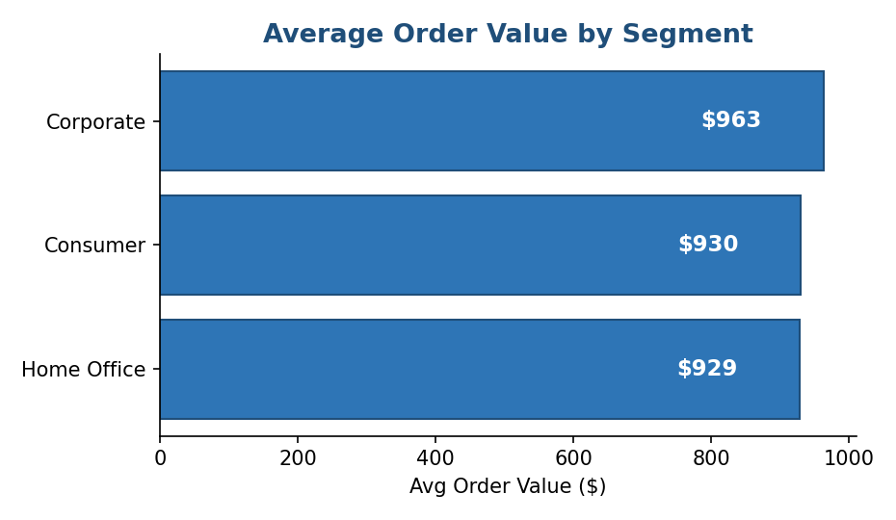
Who Spends the Most per Order?
What it tells us
Every type of customer spends about the same amount on each order, between $929 and $963.
Corporate customers spend a little more than the others, but the difference is small.
Because everyone spends a similar amount per order, we will grow by getting more orders, not by making each order bigger.

Slide 4
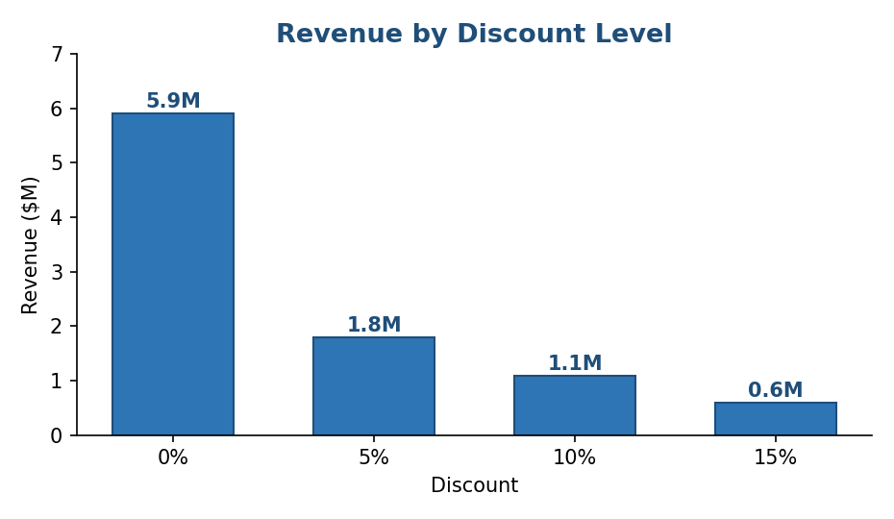
Do Discounts Drive Sales?
What it tells us
Most of our sales — $5.9 million — come from orders bought at full price, with no discount at all.
The bigger the discount, the less money those orders bring in.
This is good news: customers are happy to buy at full price, so the business does not depend on discounts to make sales.

Slide 5
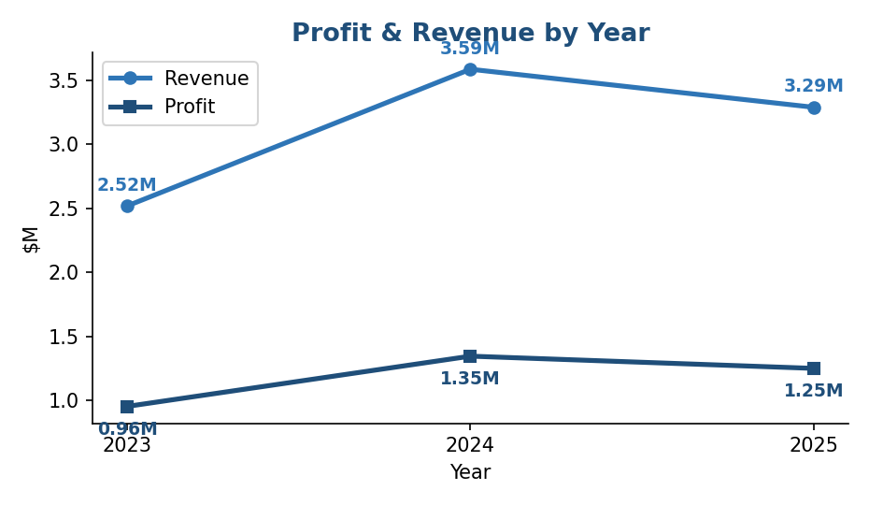
How Are We Trending Over Time?
What it tells us
Sales and profit both grew from 2023 to 2024, then stayed at about the same level into 2025.
Profit rises and falls in step with sales, which means the business keeps a steady share of each dollar it earns.
Performance is steady and easy to plan around, but it is not growing on its own — we will need to make growth happen.

Slide 6
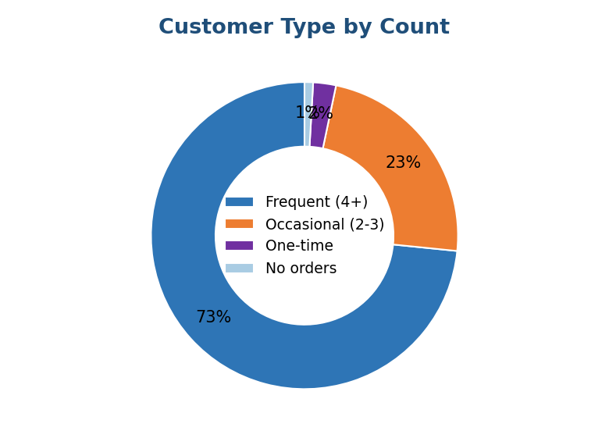
Are Customers Loyal or One-Time?
What it tells us
Most of our customers come back and buy more than once, rather than buying a single time and leaving.
Frequent and occasional shoppers make up the large majority, while one-time buyers are only a small share.
Keeping customers coming back is one of our biggest strengths, so looking after these loyal shoppers should be a top priority.

Slide 7
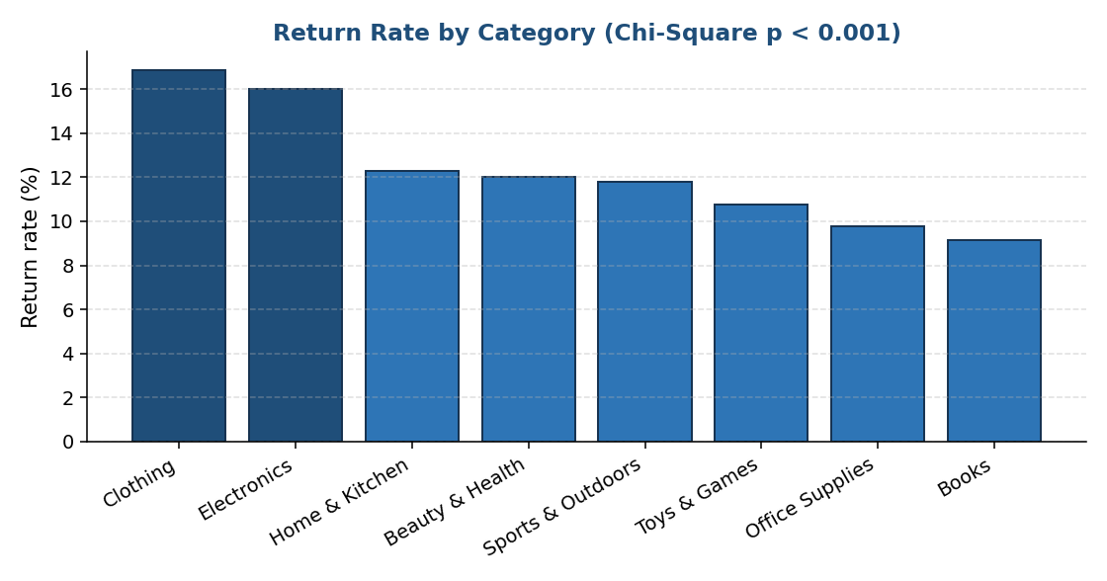
The Key Anomaly: Returns Cluster by Category
A statistically proven pattern
We ran a statistical test to check whether some categories really do get returned more often than others. The test confirmed they do, and that this pattern is real rather than chance.
Clothing and Electronics are returned about 16 out of every 100 orders — nearly twice as often as Books and Office Supplies, at around 9 out of 100.
This is a clear, real problem we can act on — not random bad luck.
About 1 in 4 orders is cancelled or returned — the biggest chance to win back lost sales.

Slide 8
Recommendations
Where to focus for the biggest impact
Cut returns where they cluster
1
Focus on Clothing and Electronics, which get returned the most. For Clothing, add better size guides and clearer product photos; for Electronics, improve the product details and quality checks.
Protect the core
2
Electronics brings in the most money, so keep it strong. Most of our sales come from everyday Consumer shoppers, so reward them with loyalty offers to keep them coming back.
Convert more orders
3
About 1 in 4 orders is cancelled or returned. Finding out why, and fixing even part of it, would bring in more money without needing a single new customer.

